Slide 1
Environmental, Social, and Governance (ESG) and you!
Does improving your company’s sustainability model help your bottom line?

Slide 2
Table of Contents
Overview
Database Framework
Deliverables
ESG Trends
Target audience
Vision
Problems to solve
Proposed solution
Team
Project objective
Data Exploration

Slide 3

Overview
Here at ESG Consultants, we are building a machine learning module to help determine the impact of sustainability on company performance.

Slide 4
What is ESG &
Why is it Important?

Slide 5
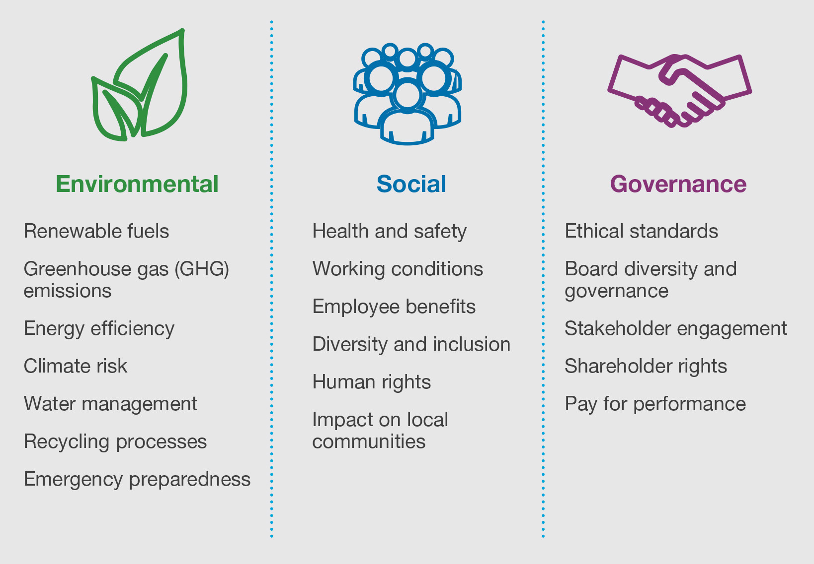
ESG Trends
01
Environment (E): 56% of population lives in cities and towns and account for 70% of CO₂ emissions by 2050 70% will live in towns and cities. The global temperature will rise by 1.5◦ C if we have Net Zero Emissions of CO₂ by 2050 otherwise may be more than 3.5◦ C.

Slide 6
ESG Trends
02
Social (S): The global population is 8 billion set to rise to 8.5 billion by 2030 and 9.7 billion by 2050. Community Relations and Human Rights, Workplace Health and Safety, Diversity and Inclusion cannot be overlooked.

Slide 7
ESG Trends
03
Governance(G): With a population of more than 8.5 billion and global temperatures rising the need for innovation in Policy and Code of Conduct, Supply Chain Management, CSR initiatives is a must for any company.

Slide 8
What do we want to know?
Is there a correlation between stock market performance and ESG ratings?
Can we balance balance ESG and turn a high profit?
1
3
2
What are the red flags that effect ESG ratings?
4
What can we do to help?

Slide 9
Project objective
Transform publicly available data from Yahoo! Finance into a database for analysis.
Build a machine learning module to evaluate performance
Visualize the results in order to make predictions and draw conclusions.

Slide 10
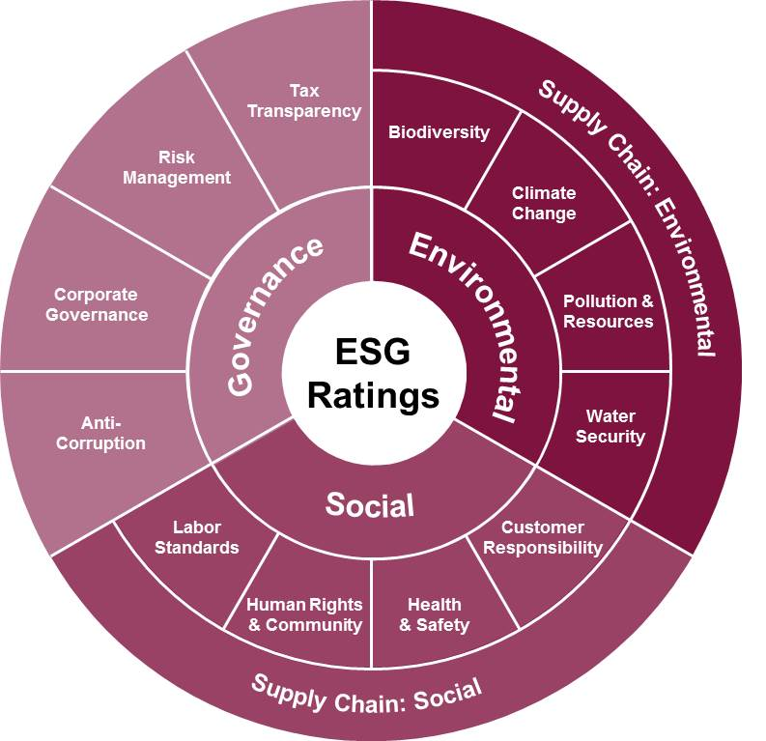
Target audience
Our dashboard is directed at financial investors who are looking to build their portfolio with sustainability in mind.
01 | Point 1 on outcome / results
02 | Point 2 on outcome / results
03 | Point 3 on outcome / results
04 | Point 4 on outcome / results
05 | Point 5 on outcome / results

Slide 11
The Data Source
Our data is from Yahoo! Finance.
Sustainability parameters like environment, social, even public sentiment for various companies which have been rated highly based on their ESG initiatives.
Five years of historical stock price data to predict the stock prices using machine learning.

Slide 12
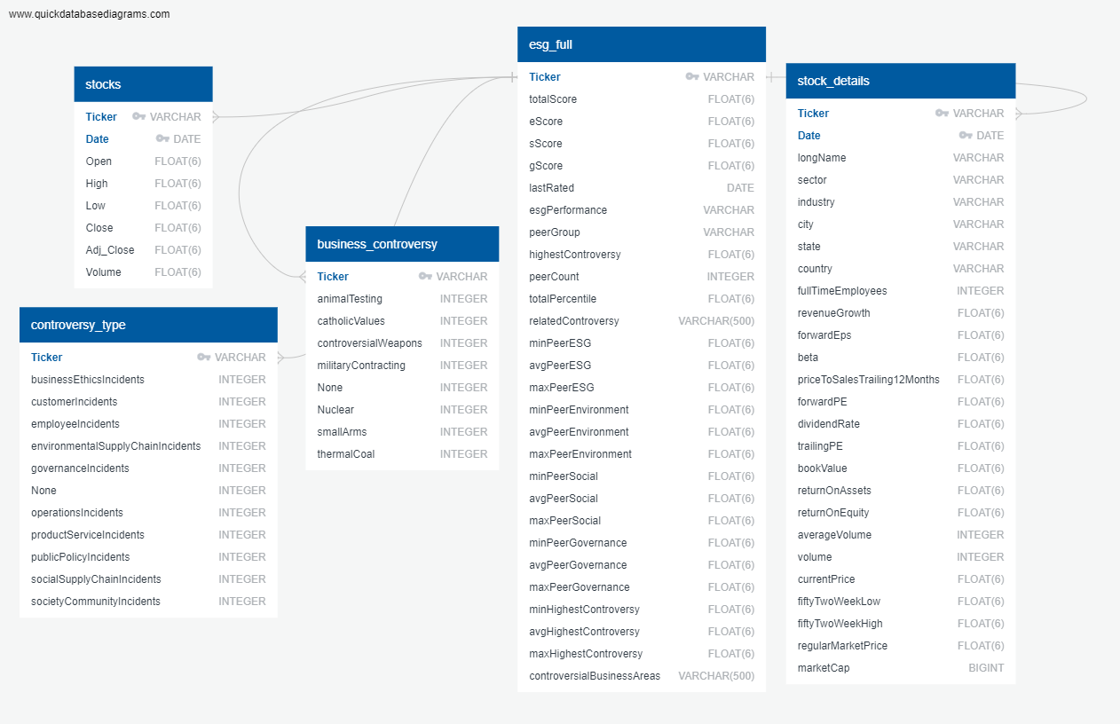
Database
Framework
Our Database contains:
stocks
controversy_type
business_controversy
esg_full
stock_details

Slide 13



Data Exploration
Feature Engineering
Training & Test Sets
Data Preprocessing
01
Identify features for optimal performance.
Ensure proper encoders
03
02
Remove duplicate/null data.
Break data into smaller tables
Remove noisy data
Use test_train_split from sklearn to split data.
Scale data accordingly

Slide 14
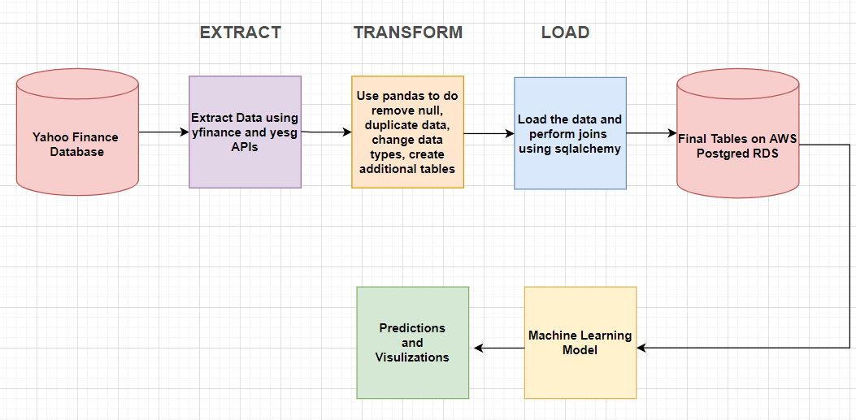
ETL Pipeline

Slide 15
Machine Learning
After reviewing various machine learning models, linear regression was used.
Benefits:
Can be used to find a colelation between ESG and company performance
Easier to implement, interpret and train efficiently
Limitations:
Notes:
Stock predictions are based on time series models (with linear regression)
Try out RIMA
Try out facebook profit
Limitations: weekends/holidays effect

Slide 16
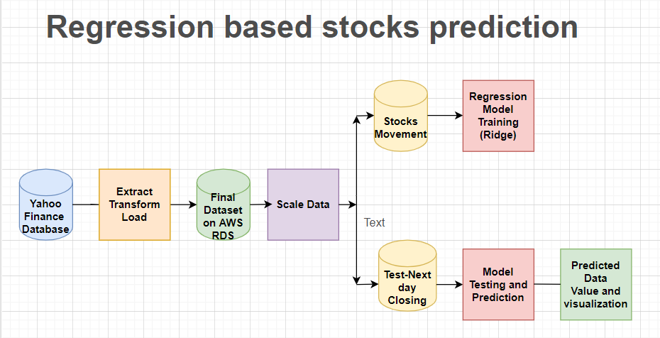
Linear Regression
Info: Info on finalized ERDs when avail

Slide 17
Proposed solution
TBD - let’s see where machine learning takes us! :)

Slide 18
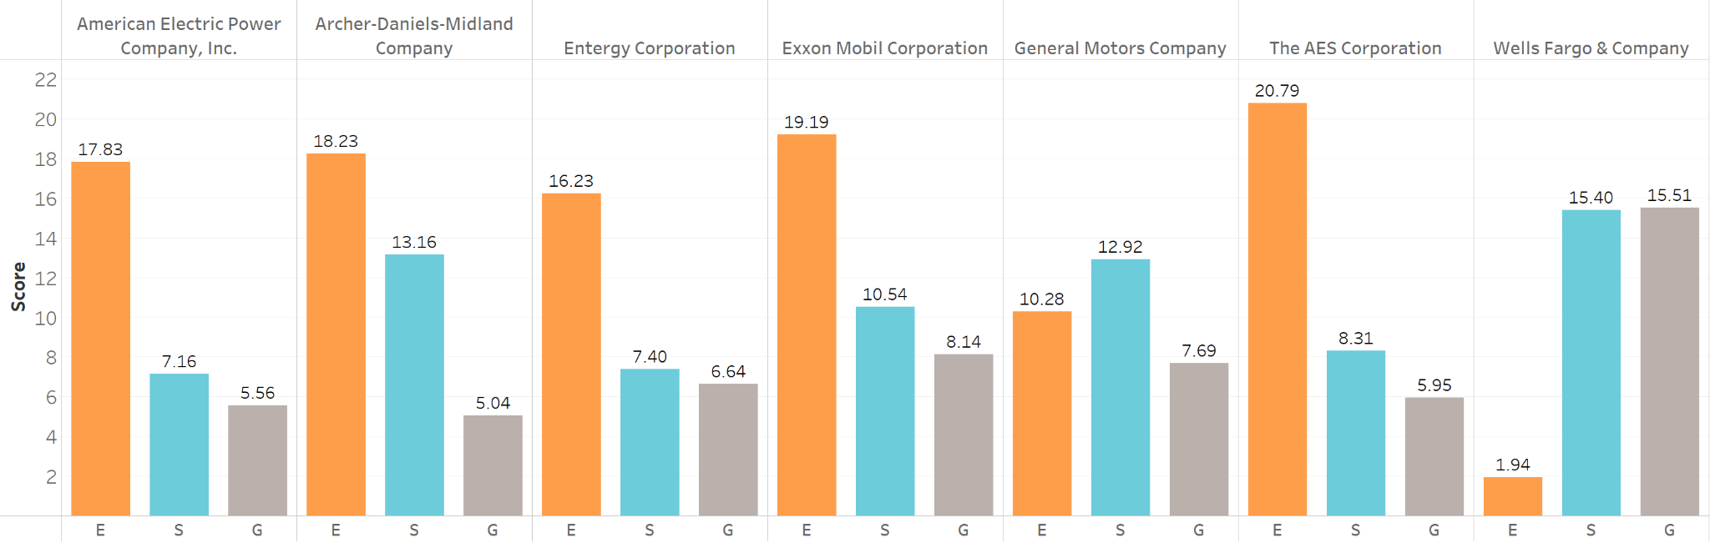
Leaders in ESG
Here are the top 7 companies based on overall ESG
100
80
60
40
20
0
Jan
Feb
Mar
Apr
May
Jun
Jul
Aug
Sep
Oct
Nov
Dec
Trend 01
Trend 02

Slide 19
Here we can include more details on our findings
Trend 01
75%
Trend 01 notes
Trend 02
53%
Trend 02 notes

Slide 20
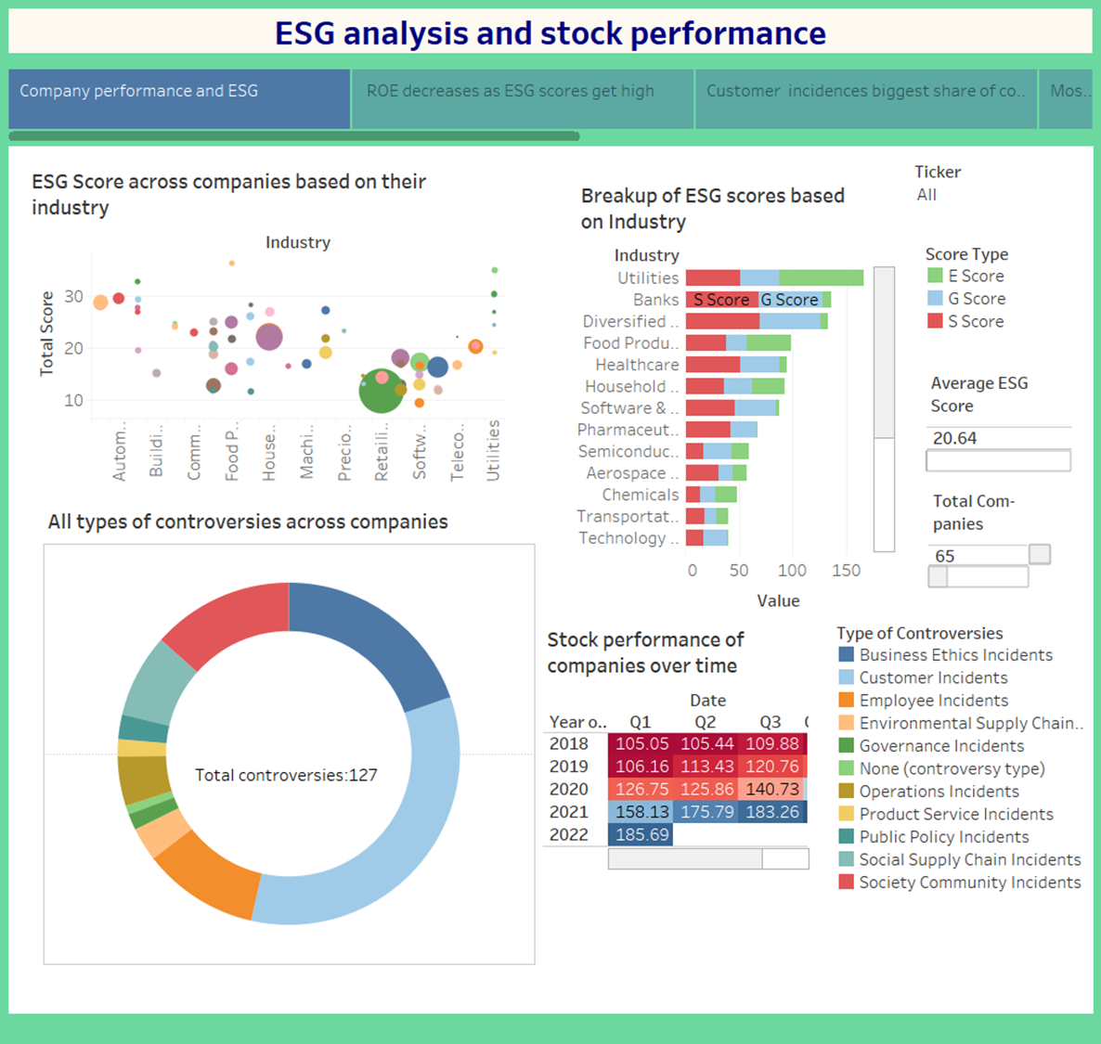
Integrated ESG Dashboard
Our interactive dashboard highlights the following areas:
ESG score by industry (bubble)
ESG score by industry (bar)
Red flags (# of incidents) by type
Stock performance over time

Slide 21
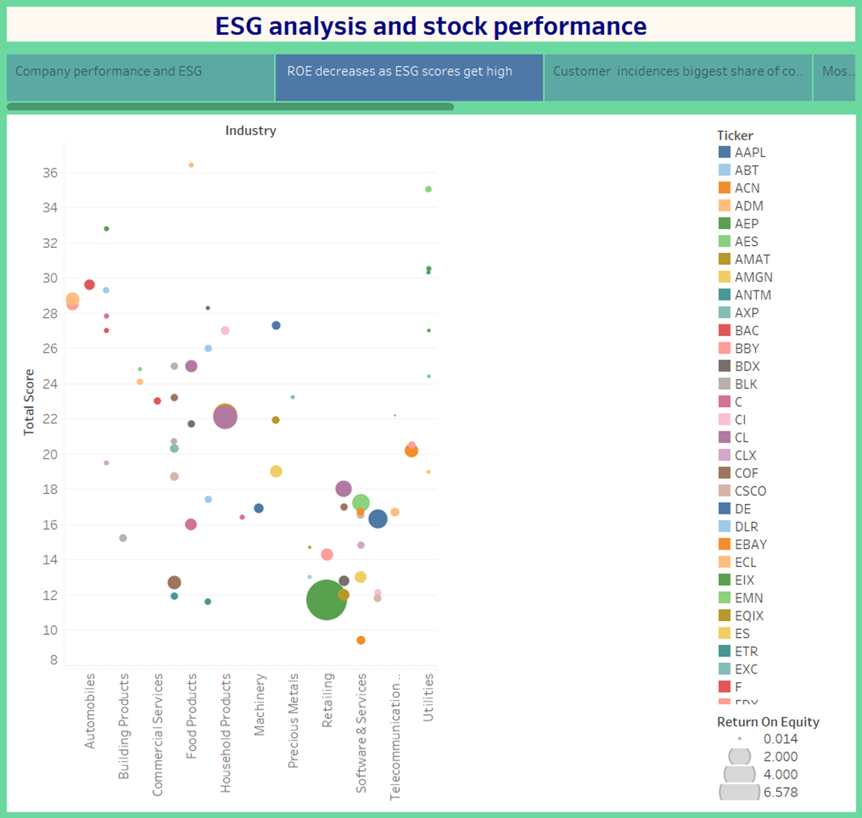
ESG Score vs RoE
Our Industry analysis concludes the following:
There is a negative correlation with RoE and ESG score
The retail industry has a high RoE, but very low ESG scores

Slide 22
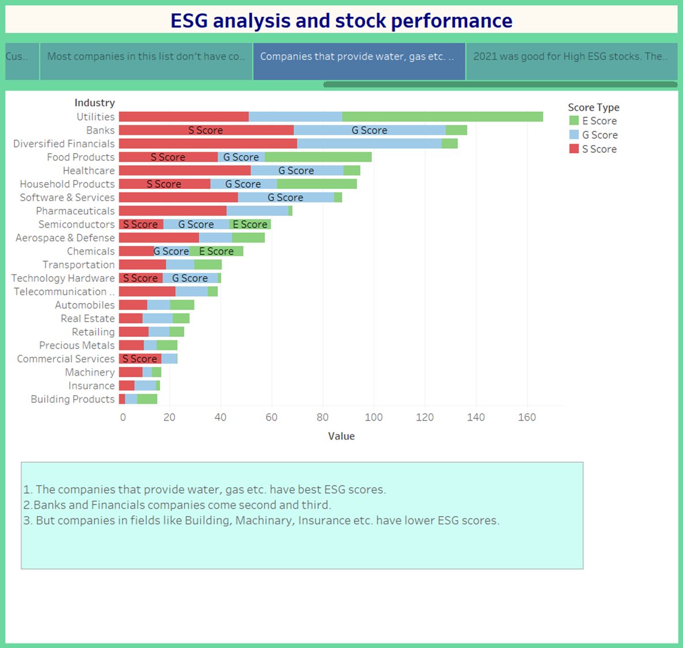
ESG score by Industry
Reviewing ESG scores by industry we can determine the following:
Utility companies have the best scores
Machinery, Insurance, Building products have low scores

Slide 23
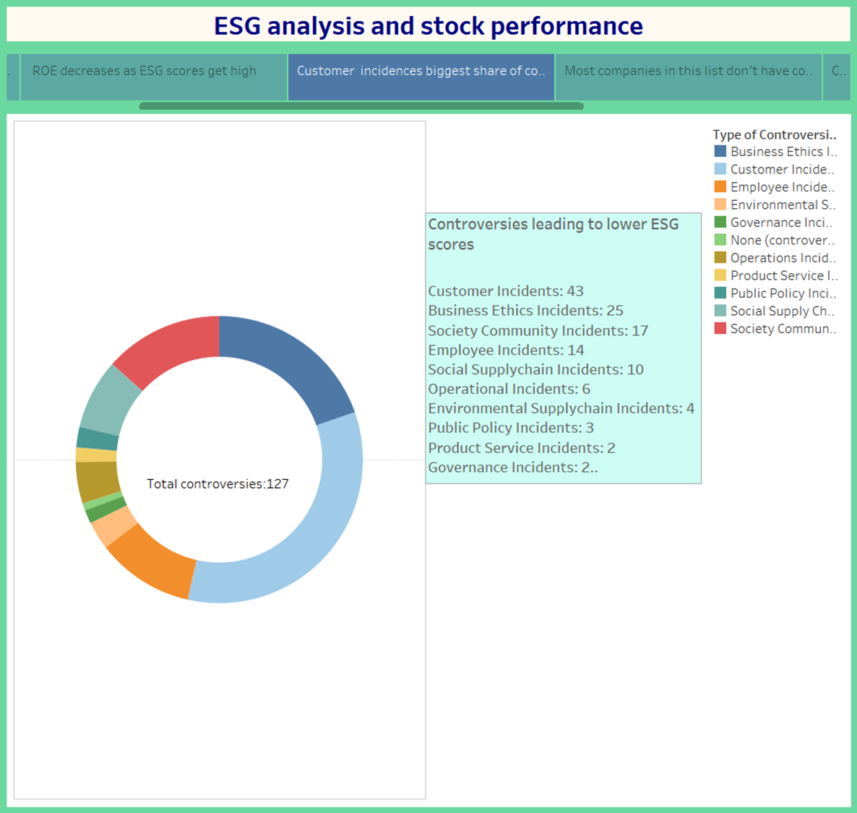
Controversy Indicators
Controversial behaviour have a negative impact on ESG scores
Business Ethics and Customer Incidents are more common types of incidents

Slide 24
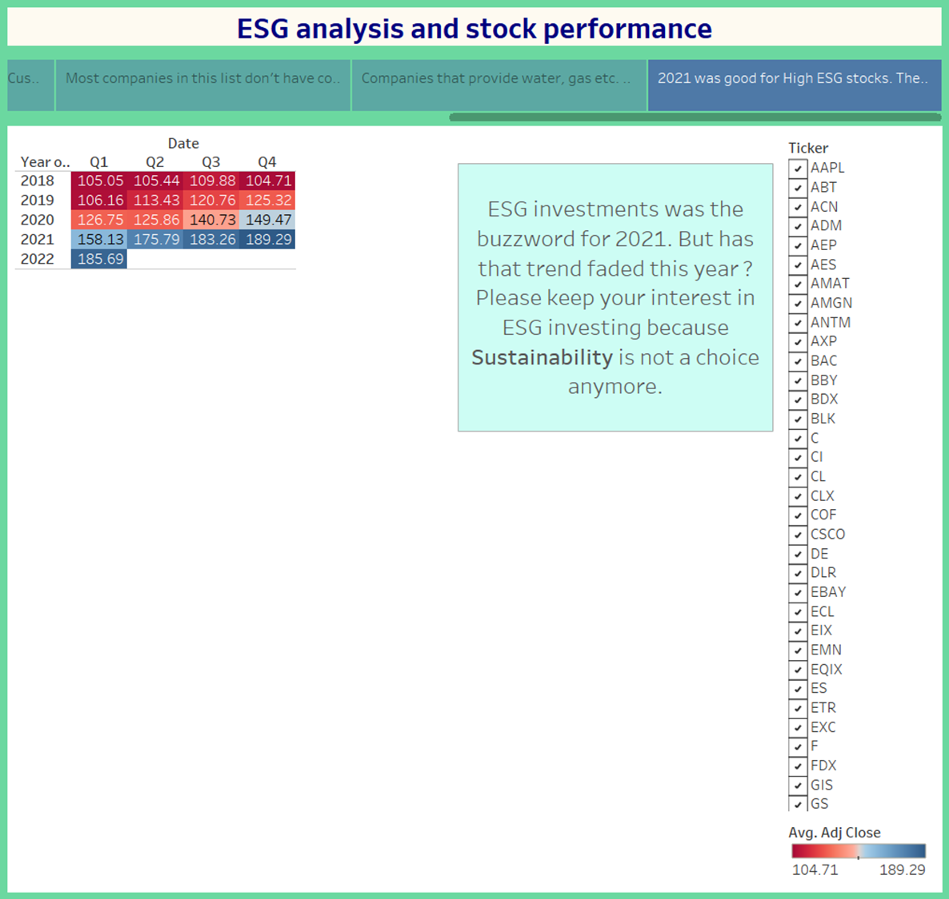
Stock Performance
Reviewing the stock performance, we can determine the following:
Performance is up as a whole

Slide 25
Deliverables
To be updated once our questions have been asked.
Metric 1
Metric 2
Metric 3
45K
690K
100K
Details on metric 1
Details on metric 1
Details on metric 1

Slide 26
Vision
Milestone 1
Milestone 3
Milestone 5
Milestone 2
Milestone 4
Details on Milestone 1
Details on Milestone 3
Details on Milestone 5
20XX
20XX
20XX
20XX
20XX
Details on Milestone 2
Details on Milestone 4

Slide 27
References
https://www.investopedia.com/terms/e/environmental-social-and-governance-esg-criteria.asp
https://ca.finance.yahoo.com/
https://ca.finance.yahoo.com/
https://www.forbes.com/just-companies/#5d410d762bf0
https://en.wikipedia.org/wiki/List_of_S%26P_500_companies

Slide 28
Thank you.

